Slide 1
English as a Lingua Franca
The changed setting

Slide 2
English as a Lingua Franca
Standard English
World Englishes

Slide 3
World Englishes
English language as it is variously used throughout the world
also known as international English, bridge language, global English
English language is now spoken in more than 100 countries
Varieties of English

Slide 4
Varieties of English
American English, Australian English, Banglish, British English, Canadian English, Caribbean English, Chicano English, Chinese English, Denglish (Denglisch), Euro-English, Hinglish, Indian English, Irish English, Japanese English, New Zealand English, Nigerian English, Philippine English, Scottish English, Singapore English, South African English, Spanglish, Welsh English, Zimbabwean English

Slide 5
Phase in the History of English
transformation of English from the mother tongue of a few nations to a language being used by far more speakers in non-mother tongue settings.
English not spoken only by British, Americans, Canadians, Australians, but all over the world. The rest of the world here outnumbering the nations to whom it is mother tongue.

Slide 6
Changes in English
Changes result from the multiplicity of the processes of microacquisition, language spread, cultural influences
One consequence of the global predominance that English has gained over the last few decades is that today non-native speakers of English far outnumber its native speakers
Thus, the critical issue of Standard English

Slide 7


Slide 8
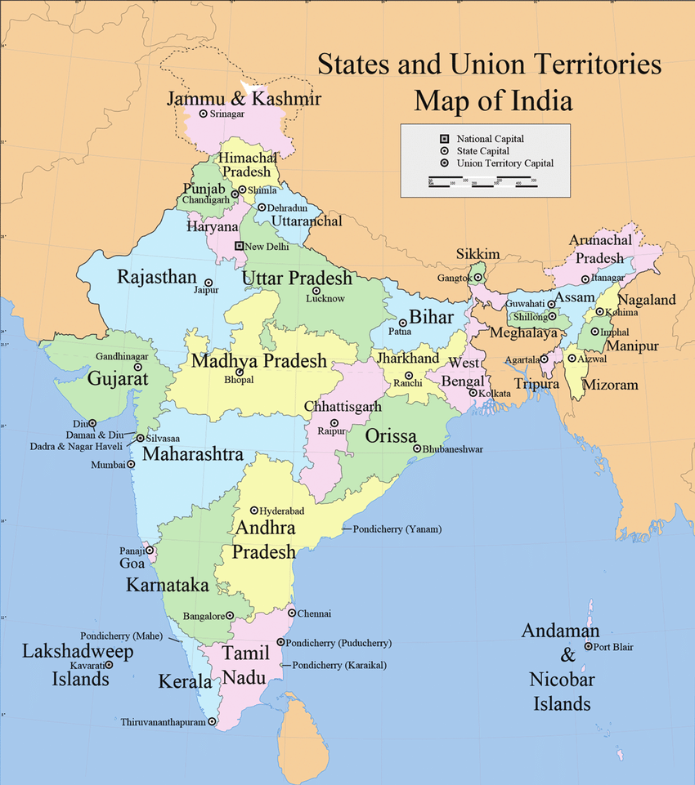
Autonomous College Durg, Chhattisgarh, India

